Slide 1


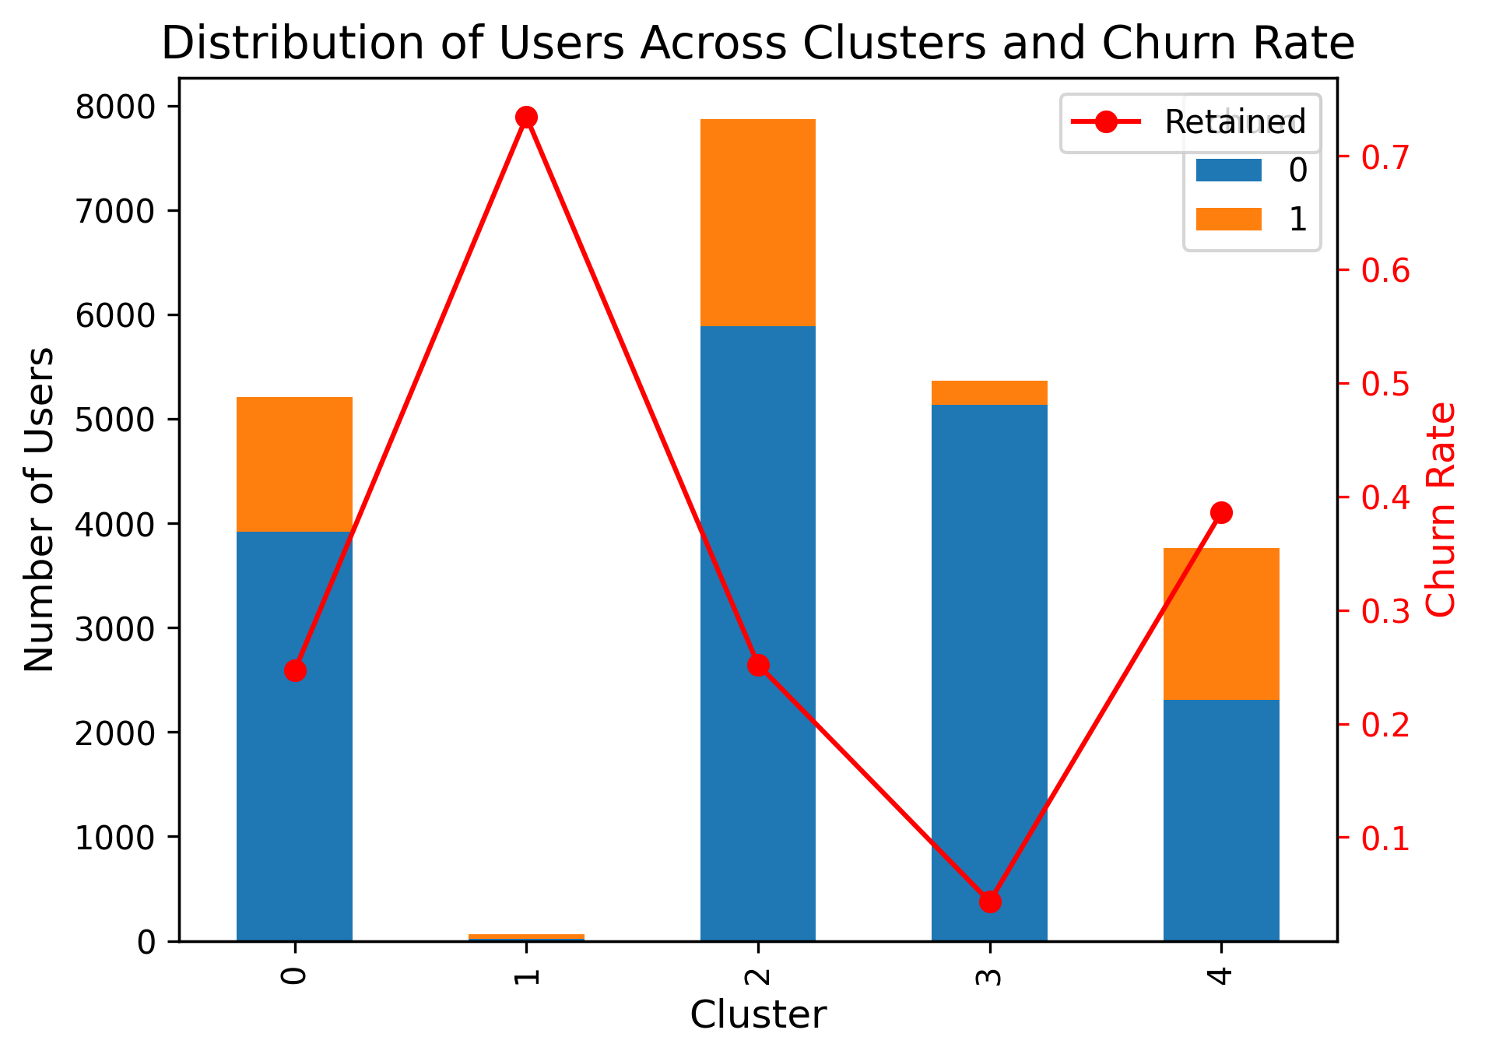
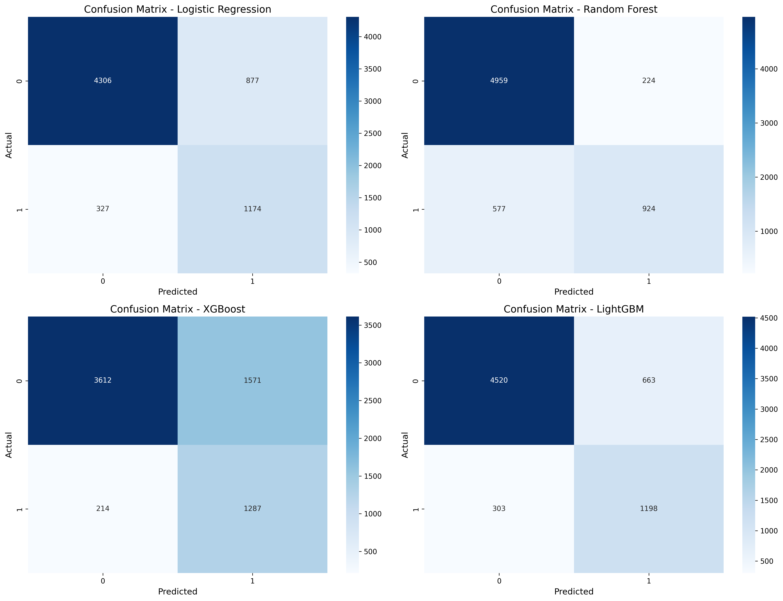
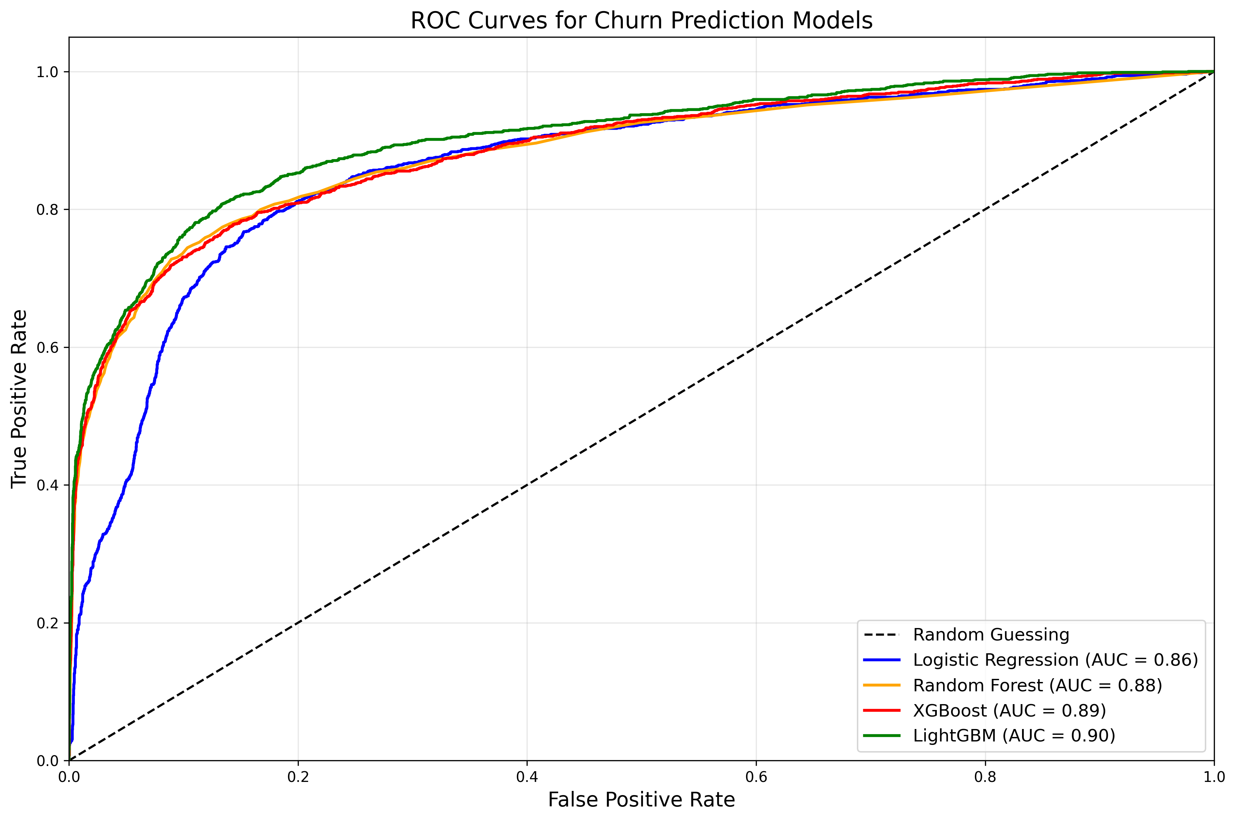
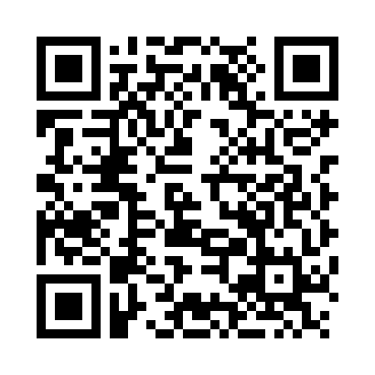
Predicting User Churn in Music Streaming Services​
Sharanya Dambe Vasudeva and Qiuyuan Zhang
INTRODUCTION
Dr. Bin Luo
DISCUSSION
This project focuses on identifying the key factors that influence customer churn and using classification algorithms to predict whether a user will confirm the cancellation of the service. The customer churn dataset provided by IEEE DataPort contains user activity log information, which we aim to analyze to discover behavioral patterns and determine the factors that contribute to a user's decision to cancel the service. We will apply methods such as feature selection, clustering, and machine learning to build a robust prediction model. The goal is to provide actionable insights for the business team to develop effective customer retention strategies.
Supervised Learning Classification Models: To predict churn, we have trained many classification models: For interpretability, we used logistic regression. Random Forest (for feature importance and stability)XGBoost (for performance on imbalanced data)LightGBM (for fast and scalable modeling)With techniques such as class_weight='balanced' or adjustment of scale_pos_weight, all models dealt with class imbalance. ROC AUC, precision, recall, and confusion matrices were utilized to quantify them. Visualization: To understand model performance and decision-making in a readily interpretable manner, the outcomes were visualized in the form of ROC curves, confusion matrices, and feature importance plots. We also illustrated the distribution of churn by user clusters to identify trends in user behavior.
METHODS
Data Collection:
The dataset of the project was gathered from IEEE data port of a music streaming company that recorded user behavior over a period. It contains approximately 26 million event records detailing user behavior such as playing music, liking a song, creating playlists, and account management through subscription change or cancellation. We can track behavior on a per-user basis across sessions because each event has a timestamp and a unique user ID. In order to get meaningful user-level features for analysis and modeling, the data needed to be parsed and aggregated from its raw JSON format.
2. Data Preprocessing:
We first transformed unstructured event logs into user-actionable features. Total listening time, average session duration, number of sessions, and number of active days were some of the metrics aggregated as part of this. We secondly utilized the presence of a “Cancellation Confirmation” event to represent churn.
3.Clustering:
Users were clustered according to their activity using a Gaussian Mixture Model (GMM) to examine user behavior patterns. This gave insightful information on what type of users tend to churn by revealing discrete behavior categories and churn rates.
RESULTS
LightGBM was the top performer overall, with a ROC AUC of 0.904, according to the final churn prediction models' results. It had a well-balanced 0.71 F1-score for the positive class, with a good recall of churned users (class 1) in particular. Second best was XGBoost with a ROC AUC of 0.887, with good recall but somewhat worse precision. Though Logistic Regression did well for a simple model, it tended to misclassify a portion of the churned users. Random Forest had good accuracy with very good performance on non-churned users. Further user segment information was uncovered with clustering analysis that found several clusters with significantly higher turnover rates. In general, the models laid a good foundation for proactive user retention initiatives through their ability to detect behavioral churn signals effectively.
REFERENCES
1. https://ieeexplore.ieee.org/document/10530632
The QR code below to learn more about the workflow of our project by viewing our code.

